Slide 1
JDBC
COMP3421
Database Systems

Slide 2
Overview
Introduction
JDBC driver types
Eclipse project setup
Programming with JDBC
Prepared statements
SQL injection attacks
Best practices

Slide 3
Introduction
JDBC (Java Database Connectivity) is a technology that allows Java applications to communicate with a database
Manages connections between the application and the database
Send DDL and DML statements to the database
Call stored database programs
Java applications interact with database-specific drivers
e.g. Oracle vs. MySQL

Slide 4
Overview
Introduction
JDBC driver types
Eclipse project setup
Programming with JDBC
Prepared statements
SQL injection attacks
Best practices

Slide 5
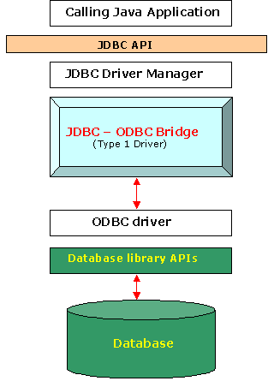
JDBC Driver Types
Type 1: JDBC-ODBC bridge
JDBC calls are converted to ODBC function calls
ODBC (Open Database Connectivity) is intended to be database and OS independent
Useful in situations where a Java application needs to communicate with an existing ODBC driver

Slide 6
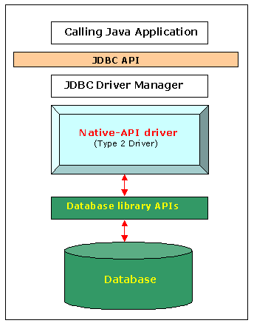
JDBC Driver Types
Type 2: Native-API Driver
JDBC calls are converted to native calls of the database API
Useful in situations where an ODBC driver isn’t needed, and an existing database library API exists

Slide 7
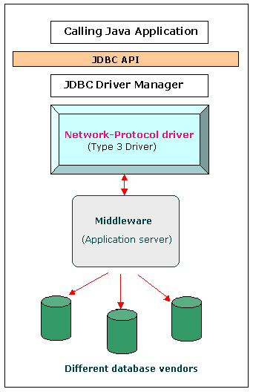
JDBC Driver Types
Type 3: Network-Protocol Driver
JDBC calls are converted directly or indirectly into the vendor-specific database protocol(s) by a middle-tier application server
Useful in situations where such an application server exists
Reduces application ties to vendor-specific database systems

Slide 8
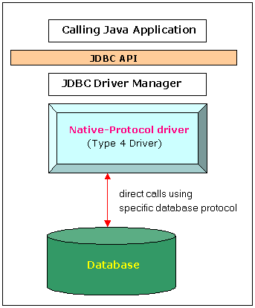
JDBC Driver Types
Type 4: Database-Protocol Driver
JDBC calls sent directly to a vendor-specific database
Useful in situations where the application is tied to a vendor-specific database
We’ll use this “thin” driver in our applications

Slide 9
Overview
Introduction
JDBC driver types
Eclipse project setup
Programming with JDBC
Prepared statements
SQL injection attacks
Best practices

Slide 10
Eclipse Project Setup
Download and import the appropriate JDBC driver jar file (MySQL or Oracle driver available on web)
Import the jar file to your project
You may need to “refresh” your project first
Add the jar to your project’s build path
Select your project.. Right click > Build Path… > Add External Libraries

Slide 11
Overview
Introduction
JDBC driver types
Eclipse project setup
Programming with JDBC
Prepared statements
SQL injection attacks
Best practices

Slide 12
Programming with JDBC
Steps
Import the Java sql package
Create a database connection object using…
The JDBC driver identifier and database URL
Database user credentials
Create “Statement” objects as needed using…
The database connection
A string containing the SQL to execute
Execute the statement, which may return a “ResultSet”
Iterate through the records in the ResultSet, accessing field values one record at a time
Close the ResultSet, Statement, and Connection objects

Slide 13
Programming with JDBC
import java.sql.*;
public class DBTest {
public static void main(String[] args) {
String db_url = "jdbc:mysql://localhost/comp3421";
String user = "root";
String pass = "ilovesql";
try {
Connection conn =
DriverManager.getConnection(db_url, user, pass);
Import the Java sql package
Create a database connection object

Slide 14
Programming with JDBC
Statement stmt = conn.createStatement();
String sql = "SELECT cust_id, cust_name FROM
candy_customer";
ResultSet rs = stmt.executeQuery(sql);
while (rs.next()) {
int cust_id = rs.getInt("cust_id");
String name = rs.getString("cust_name");
System.out.println("custID: " + cust_id +
", name " + name);
}
} catch (SQLException e) {
e.printStackTrace();
}
}
Create a statement object
Create a resultset object
Iterate through the records in the resultset accessing field values one record at a time

Slide 15
Programming with JDBC
Executing a statement object
executeQuery(String sql)
Useful for executing SELECT statements
Returns a ResultSet object
executeUpdate(String sql)
Useful for executing INSERT, UPDATE, and DELETE statements
Returns the number of rows affected
execute(String sql)
Useful for executing DDL statements
Returns a boolean value indicating whether a ResultSet object can be retrieved

Slide 16
Programming with JDBC
Using the ResultSet object
next()
Retrieves the next record in the results (if it exists)
Returns a boolean indicating whether or not another record exists in the result set
getString(String fieldName)
Returns the value of the input field name for the current record in the result set and formats it as a String
Similar methods exist for other types
getInt(String), getDate(String), getObject (String)
These also return and format values in the result set

Slide 17
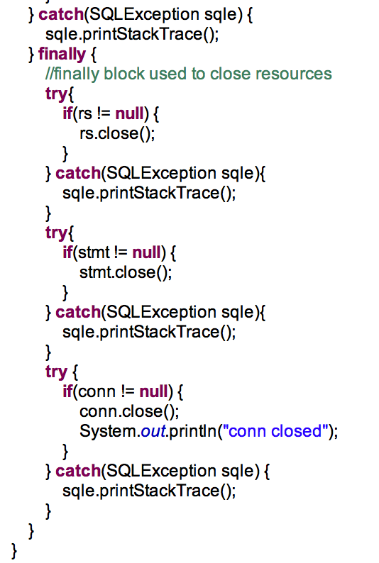
Programming with JDBC
Close the ResultSet, Statement, and Connection objects
Close these objects in a finally block so that they are closed regardless of whether or not an exception occurs
Some third party libraries will do this for you if you use their database connectivity utilities

Slide 18
Overview
Introduction
JDBC driver types
Eclipse project setup
Programming with JDBC
Prepared statements
SQL injection attacks
Best practices

Slide 19
Prepared Statements
The Statement objects that we’ve seen thus far execute static SQL commands
Applications often need to execute dynamic queries based on user input
The PreparedStatement class allows for dynamic queries whose values may be provided at runtime
Prepared statements are compiled using placeholders for parameters
These parameters are then inserted using values provided by the user at runtime

Slide 20
Prepared Statements
Why use prepared statements?
More efficient than Statement objects that accept an SQL string constructed at runtime
Prevents SQL injection attacks when used to execute action queries
More on this shortly…
Approach
Create a query string using ? as a placeholder for a parameter value
Do not include single quotes for strings
Use set methods to specify parameter values for the ? placeholders

Slide 21
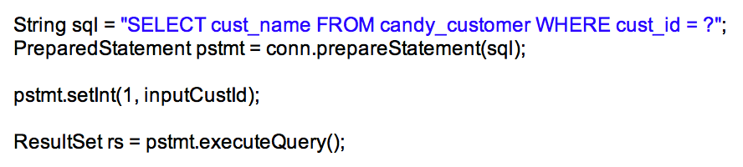
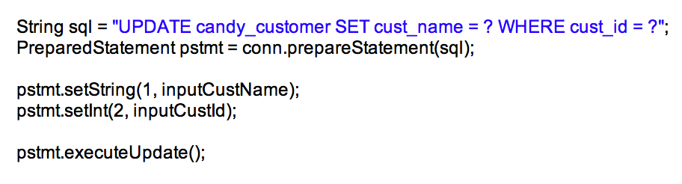
Prepared Statements
Examples
Retrieving data
Updating data
Parameter assignment begins with 1 (not 0)
Call PreparedStatement’s executeQuery() method when executing a SELECT statement
Call PreparedStatement’s executeUpdate() method when executing an INSERT, UPDATE, or DELETE statement

Slide 22
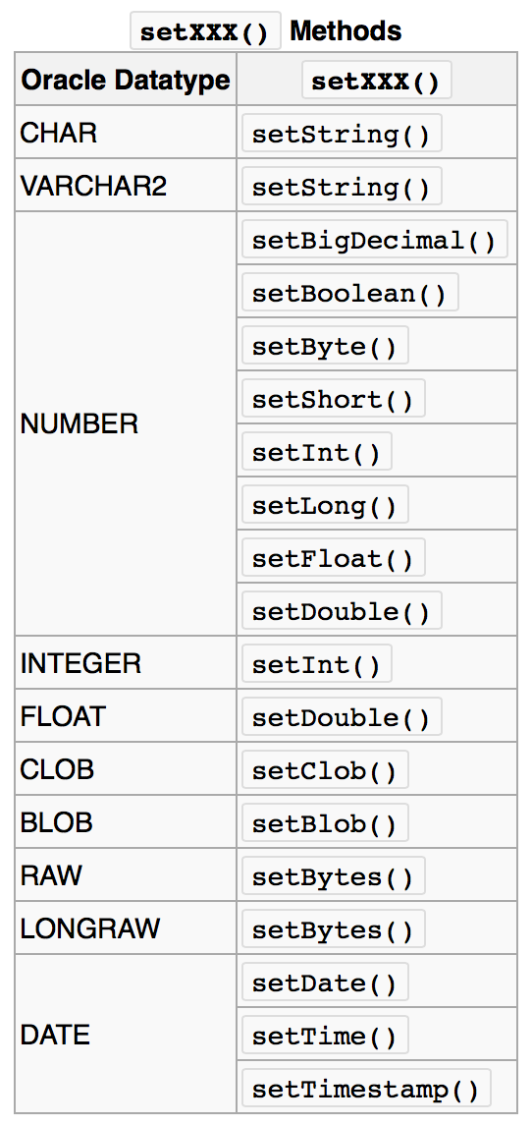
Prepared Statements
Type conversions between Oracle data types and Java data types
The same Oracle/Java data types are compatible using the JDBC getXXX() methods

Slide 23
Overview
Introduction
JDBC driver types
Eclipse project setup
Programming with JDBC
Prepared statements
SQL injection attacks
Best practices

Slide 24
SQL Injection Attacks
An SQL injection attack is an attack on a database-driven application in which the attacker executes unauthorized SQL commands
Possible when a query is constructed using user input values
They can be prevented using input validation

Slide 25
SQL Injection Attacks
Injection types
Incorrectly filtered escape characters
Incorrect query termination
statement = “SELECT * FROM users WHERE name = ‘” + userName +
“’ AND password = ‘” + userPassword + “’”; User input (stored in both variables): ‘ OR ‘t’ = ‘t Rendered as: SELECT * FROM users WHERE name=‘’ OR ‘t’=‘t’
AND password = ‘’ OR ‘t’=‘t’
statement = “SELECT * FROM data WHERE id = “ + someId; User input (stored in someId): 1;DROP TABLE users Rendered as: SELECT * FROM DATA WHERE id=1;DROP TABLE users

Slide 26
SQL Injection Attacks
How to prevent SQL injection attacks
Prepared statements will prevent these types of SQL injection attacks
Other programming languages have “parameterized” statements similar to JDBC’s “prepared” statements
Filtering
Manually parse and remove dangerous characters from user input
May be difficult to anticipate all possibilities

Slide 27
Overview
Introduction
JDBC driver types
Eclipse project setup
Programming with JDBC
Prepared statements
SQL injection attacks
Best practices

Slide 28
Best Practices
Close JDBC related objects (connections, statements, result sets, etc.) in a finally block whenever possible
This ensures that these objects will be closed whether or not an exception occurs
The database limits the number of open connections that a user can have
Could max out if left open
Use prepared statements whenever a query requires parameters
Safer and more efficient

Slide 29
Best Practices
Minimize database connections whenever possible
These are expensive and can be reused
Some 3rd party libraries can manage database “connection pools” for you
Decouple your application’s business logic and data models from JDBC usage as much as possible
Allows your application to use other data sources more easily

